Slide 1

CASE STUDY ANALYSIS
Ginkgo Bioworks: Engineering Biology for a Better Future
Prepared by: Your Name: BYIRINGIRO Valens
CodeAlpha Biotechnology Internship
June 2026

Slide 2
COMPANY BACKGROUND
Founded in 2008
Headquarters: Boston, Massachusetts, USA
A biotechnology company specializing in synthetic biology
Uses engineered microorganisms to solve challenges in healthcare, agriculture, food, and industrial manufacturing.
Mission
To make biology easier to engineer

Slide 3
BIOTECHNOLOGY INNOVATION
Main Innovation
Ginkgo Bioworks designs microorganisms such as bacteria and yeast using genetic engineering techniques. These engineered microorganisms perform useful biological functions that improve industrial processes.
Examples
Engineered bacteria
Engineered yeast
Synthetic DNA
Cell programming
These innovations reduce production costs while improving efficiency and sustainability.

Slide 4
APPLICATIONS
Agriculture
Biofertilizers
Biological pesticides
Improved crop health
Food Industry
Alternative proteins
Food ingredients
Flavor production
Healthcare
Vaccine development
Drug discovery
Disease diagnostics

Slide 5
APPLICATIONS CONT’
Industrial Biotechnology
Biofuels
Sustainable chemicals
Biomanufacturing

Slide 6
BIOTECHNOLOGY USED
Technologies Applied
Synthetic Biology
Genetic Engineering
DNA Sequencing
Artificial Intelligence
Automation
Bioinformatics
These technologies enable scientists to design microorganisms with specific functions for different industries.

Slide 7
BENEFITS
Advantages of Ginkgo Bioworks Innovation
Sustainable production
Reduced environmental pollution
Faster biotechnology research
Improved agricultural productivity
Reduced chemical use
Supports food security
Its innovations contribute to environmentally friendly industrial production.

Slide 8
CHALLENGS
Challenges Faced
High research and development costs
Strict biotechnology regulations
Ethical concerns about genetic engineering
Public acceptance of biotechnology products
Strong competition from other biotechnology companies
These challenges influence the commercialization and adoption of biotechnology innovations.

Slide 9
MARKET IMPACT
Impact on the Biotechnology Industry
Ginkgo Bioworks has become one of the world's leading synthetic biology companies.
Its technologies have:
Increased investment in biotechnology.
Accelerated biological research.
Supported sustainable agriculture.
Improved industrial biotechnology.
Created partnerships with pharmaceutical and agricultural companies.

Slide 10
RELEVANT TO MY COUNTRY (RWANDA)
Importance for Rwanda
Although Ginkgo Bioworks is based in the United States, its technologies have potential applications in Rwanda.
Examples include:
Development of sustainable biofertilizers.
Improvement of crop productivity.
Reduction of chemical fertilizer use.
Support for climate-smart agriculture.
Reduction of postharvest losses through biotechnology innovations.
These applications can contribute to food security and sustainable agricultural development.

Slide 11
CONCLUSION
Conclusion
Ginkgo Bioworks demonstrates how synthetic biology can transform agriculture, healthcare, and industrial production.
Its innovative biotechnology solutions improve sustainability, productivity, and environmental protection.
Despite challenges such as regulatory requirements and research costs, the company continues to influence the future of biotechnology through scientific innovation and strategic partnerships.

Slide 12
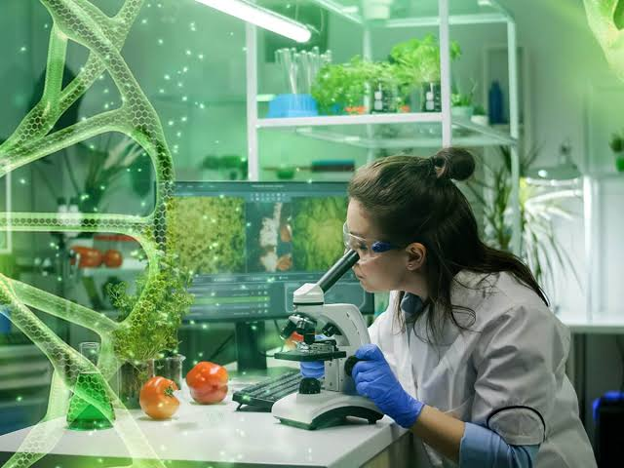
Thank You!

